Slide 1
Shuffleboard Pros
HUDK 4050, GROUP 7.
K. David Pearce, Shu-Yi Hsu, Yiwei Qi, Joellyn Heng, Alysandra J. Zhang

Slide 2
Research Questions
Q1: Is there a feature that differentiates between novice and expert shuffleboard players? If so, what?
Q2: Will the intervention we implemented enable novices to improve upon their shuffleboard performance?

Slide 3
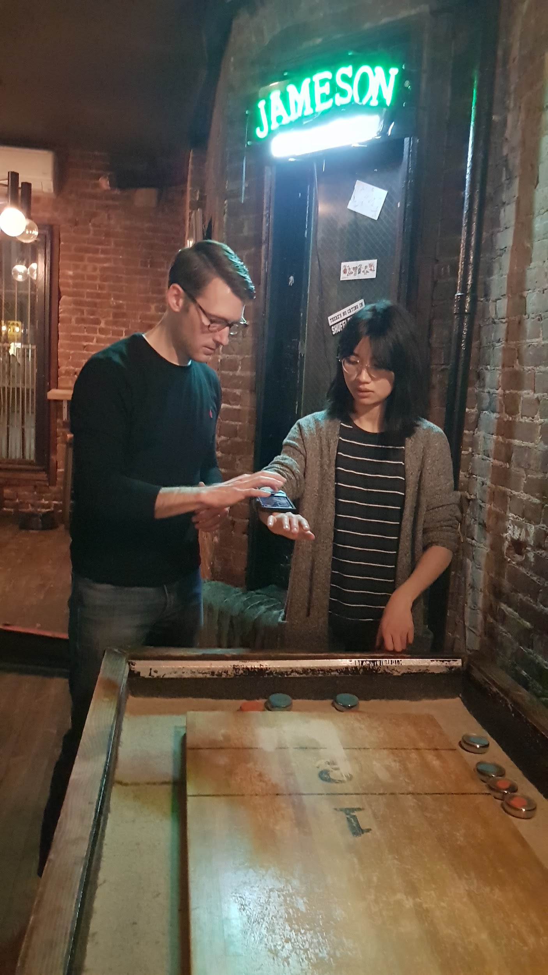
Logistics
Materials: Samsung Galaxy S10, Sensor Kinetics App Pro
One standard-sized shuffleboard table at a bar in NYC called Bob’s Your Uncle
Use duct tape to affix phone to dominant forearm to measure acceleration when playing shuffleboard

Slide 4
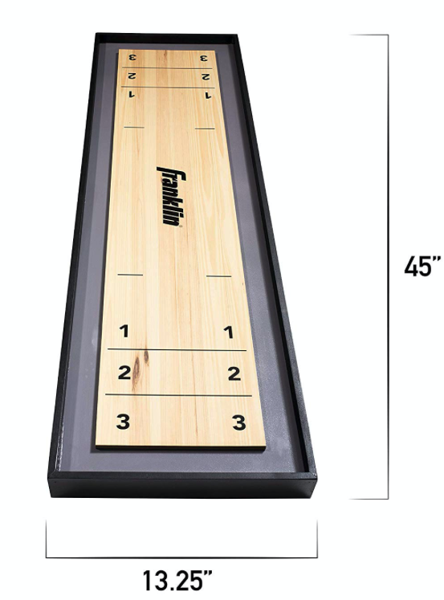
Research methods
Pre-intervention: Participants (n=5) played game, and established “Expert” and “Novice” through Total score.
Determining intervention: Identifying feature (independent variable) that differentiates scores (dependent variable).
Intervention applied: Increasing peak Y-value per throw, i.e. maximum acceleration (independent variable).
Post-intervention: Novices increased maximum acceleration, and score was re-evaluated.

Slide 5
Pre-intervention
“Expert” vs “Novice” group were established through total scores.
 | Throw 1 | Throw 2 | Throw 3 | Throw 4 | Total Score
David | 0 | 3 | 3 | 0 | 6
Yiwei | 0 | 0 | 0 | 3 | 3
Joellyn | 0 | 2 | 0 | 0 | 2
Alysandra | 0 | 1 | 0 | 1 | 2
Shu-Yi | 0 | 3 | 0 | 1 | 4
*expert*
novice
novice
Expert
but bad day
*expert*

Slide 6
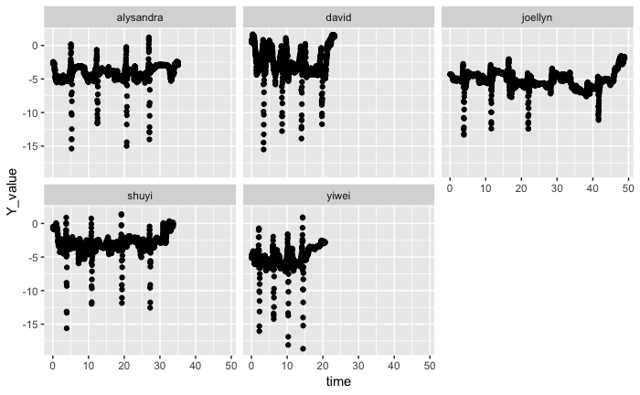
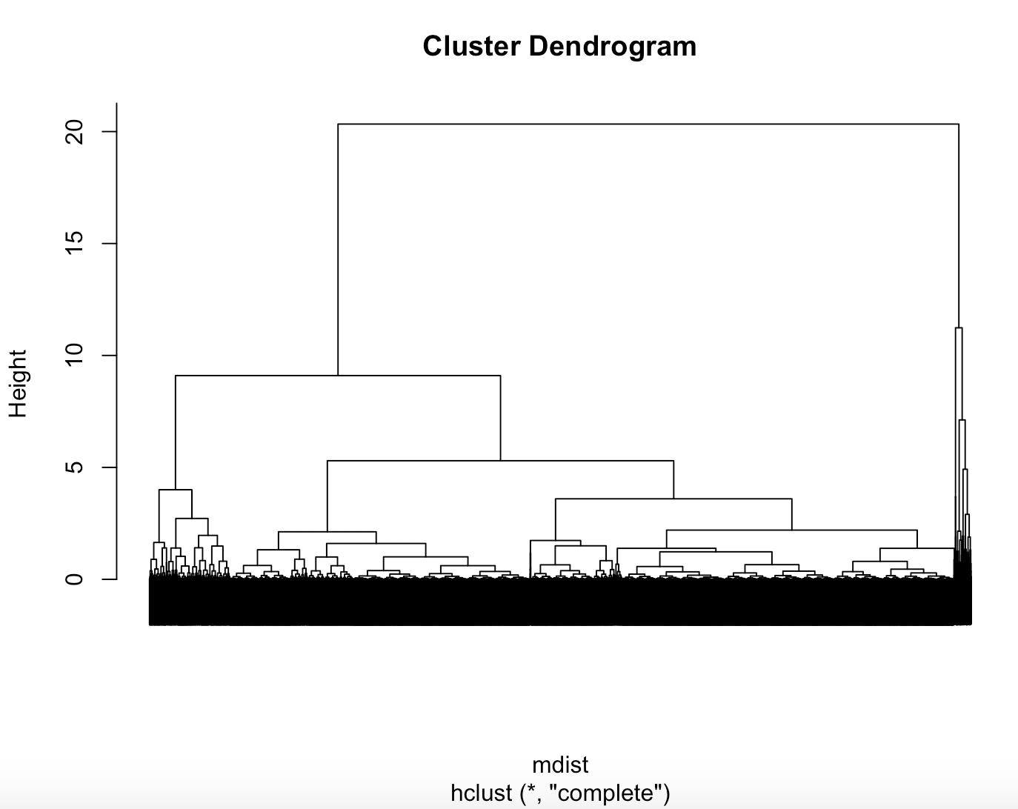
Determining intervention
Expert
but bad day
*expert*
novice
*expert*
novice

Slide 7
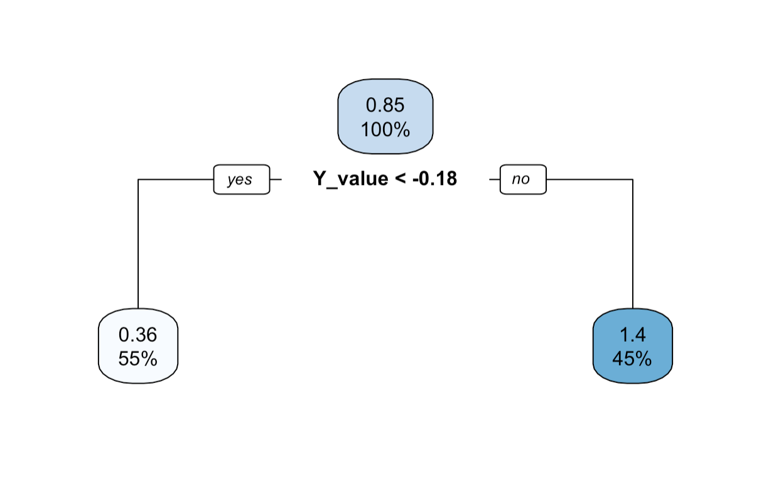
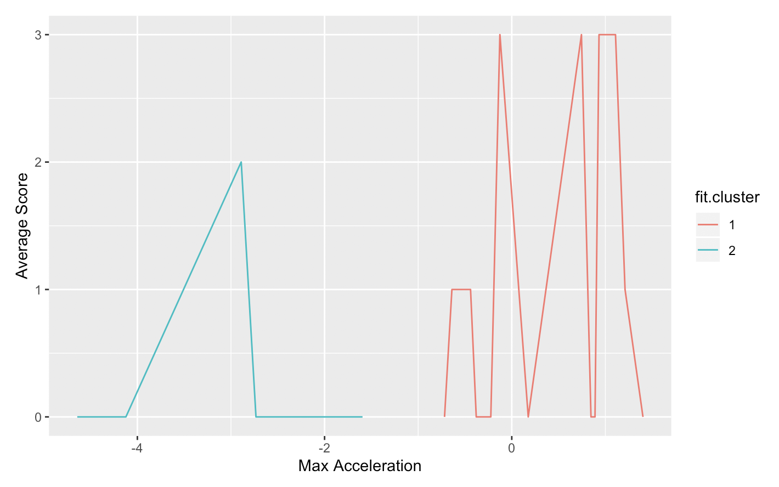
Determining intervention
The regression decision tree shows that a higher maximum acceleration results in a higher mean score per throw in the sample.
The K-means clustering shows that a higher maximum acceleration results in higher average scores per throw.

Slide 8
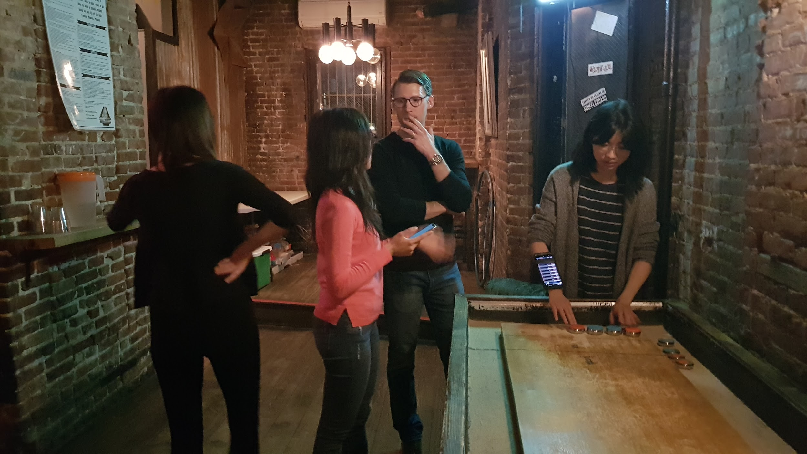
Intervention & Post-intervention
From the data, it is observed that higher maximum acceleration generally results in a higher mean score.
Apart from that, the established “experts” also gave one-on-one coaching for each “novice” on other techniques (e.g. force applied, direction and finesse).
After receiving feedback, each member played three trials (4 pushes each). Similarly, the highest scoring trial was counted.

Slide 9
Recall: Pre-intervention data
 | Averaged Max Acceleration | Averaged Score
David | 0.362 | 1.5
Yiwei | -0.834 | 0.75
Joellyn | -3.597 | 0.5
Alysandra | 0.131 | 0.5
Shu-Yi | 0.649 | 1
Focus of intervention

Slide 10
Post-intervention data
 | Averaged Max Acceleration | Averaged Score
David | 0.223 | 2
Yiwei | -0.564 | 0.75
Joellyn | -3.424 | 1.5
Alysandra | -1.826 | 1.25
Shu-Yi | N/A | N/A

Slide 11
Conclusion
The feature that differentiates scores seems to be maximum acceleration.
Higher maximum acceleration of a shuffleboard disk push seems to suggest higher score per push on average.
The intervention seems to have improved “novice” performance, but the effect of intervention was insignificant and mixed (e.g. for experts, lower max acceleration resulted in higher score).
Limitations:
There are other variables involved that would affect scoring (e.g. configuration of the board, direction)
Small sample (n = 5) and Convenience sampling (e.g., group selection based on geodesic distance, approximating performance with highest scoring trial)
(According to Alysandra, the “expert on a bad day”) The shuffleboard table at Bob’s Your Uncle may have been crooked.

Slide 12

Gratitude to Bob’s Your Uncle NYC and patrons for letting five graduate students take turns duct-taping themselves with the same smartphone, and then proceed to hog the shuffleboard for 3 hours.

Slide 13
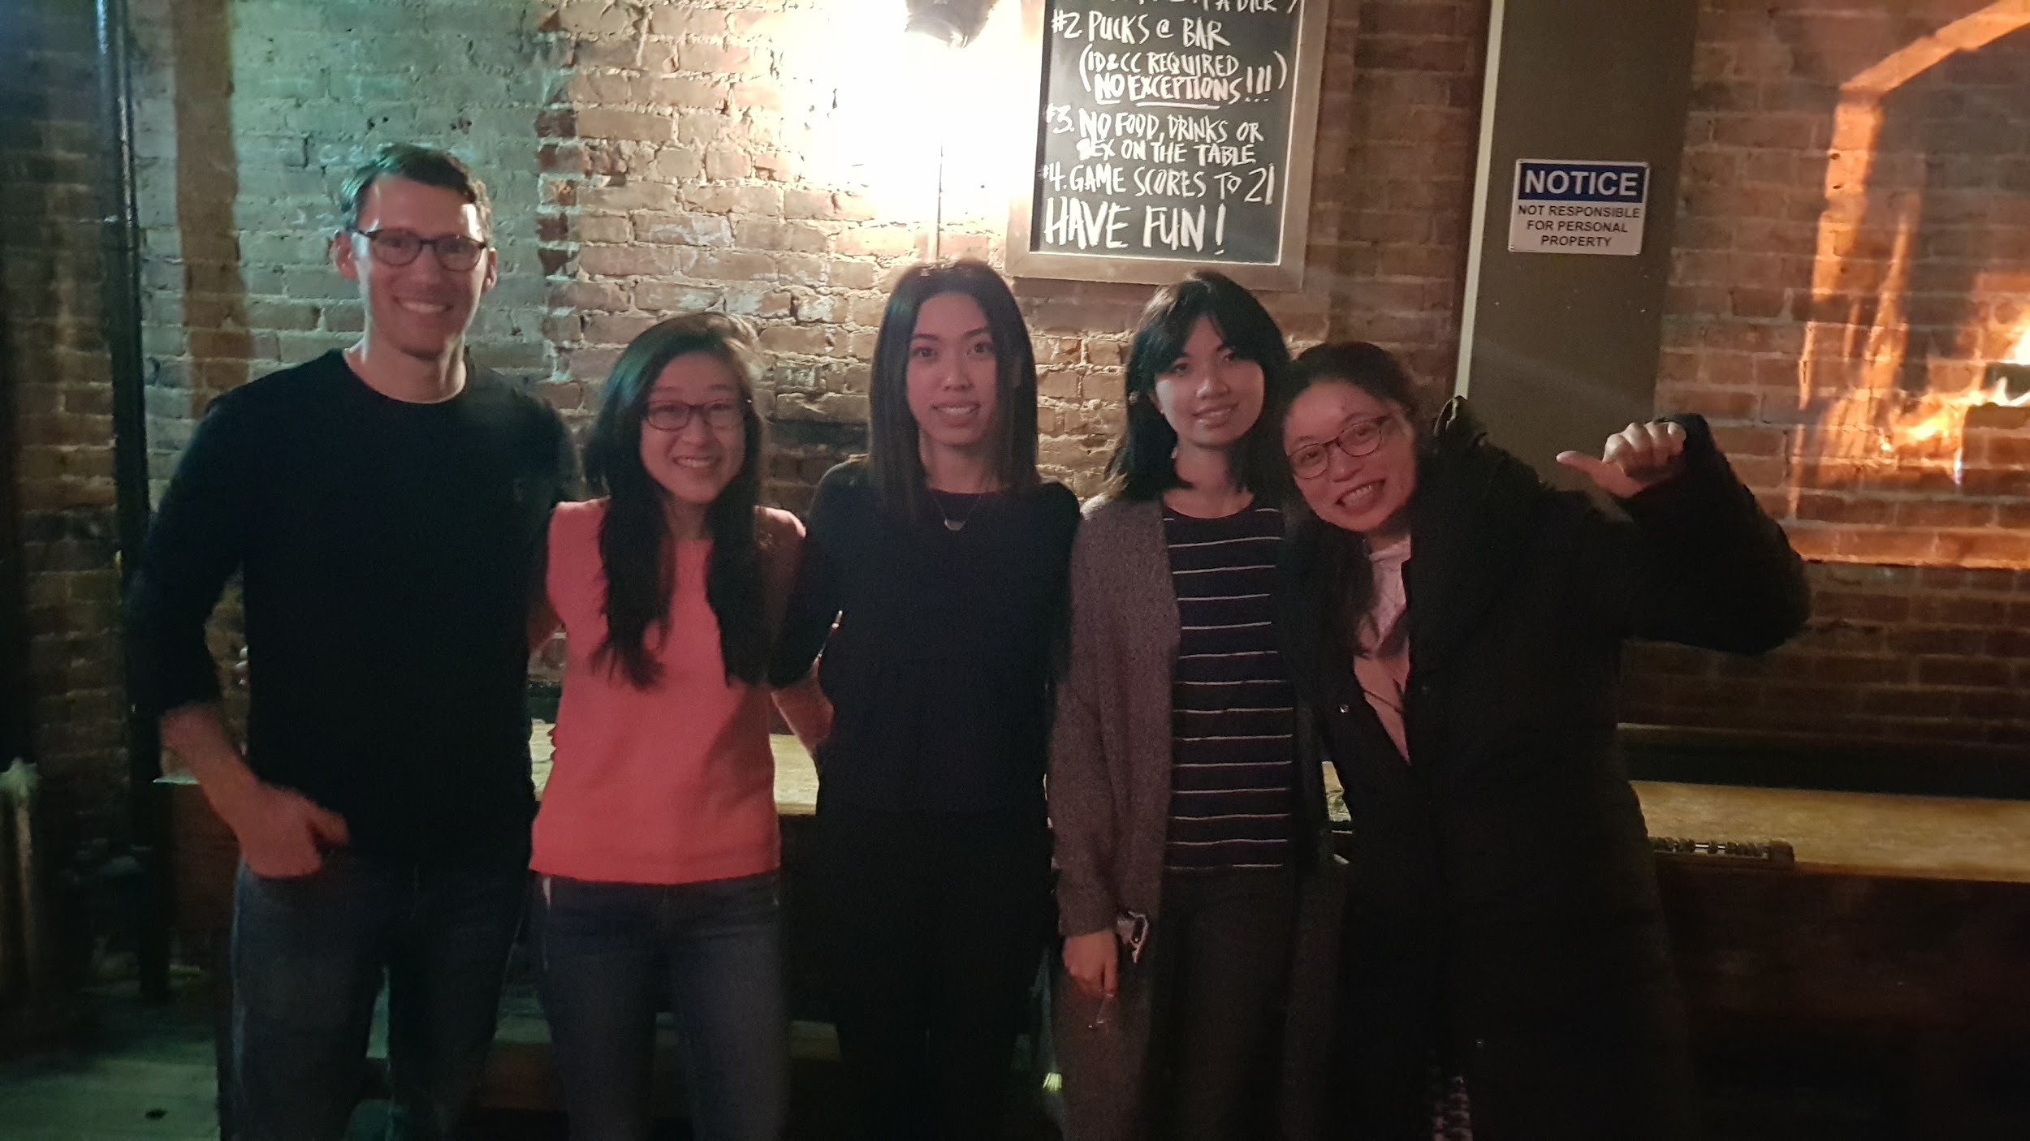
N_{e}

